Slide 1
Introduction to Horticulture
Unit 1

Slide 2
Introduction to Horticultural Science Framework 1.1
1. CDE – career development event
2. Entrepreneur – one who works for oneself
3. Floriculture – the science and practice of growing, harvesting, storing, designing, marketing, and distributing foliage and/or flowering plants
4. Horticulture – literally means “garden cultivation”; includes the cultivation, processing, and sale of fruits, nuts, vegetables, ornamental plants, and flowers

Slide 3
Introduction to Horticultural Science Framework 1.1
5. Interiorscaping – using live plants to landscape indoor areas; also known as plantscaping
6. Landscaping – the science and practice of installing, maintaining, and using grasses, plants, shrubs, and trees in the landscape
7. Olericulture – the science and practice of growing, harvesting, storing, processing, and marketing vegetables
8. Ornamental horticulture – the practice of growing and using plants for decorative purposes

Slide 4
Introduction to Horticultural Science Framework 1.1
9. Placement – working for someone else
10. Pomology – the science and practice of growing, harvesting, handling, storing, processing, and marketing tree fruits
11. Proficiency – an award for an individual’s SAE
12. SAE – supervised agricultural experience

Slide 5
Ornamental Horticulture

Slide 6
Ornamental Horticulture
Growing plants for their beauty
Used for aesthetic qualities for their appeal to the human senses
Can be further broken down into Floriculture and Landscaping.

Slide 7
Nursery/Landscape

Slide 8
Nursey/Landscape
Landscaping
-deals with producing plants to make outdoor environment more appealing
Landscape Designer
-designs planting plants
-installs plant material
Maintains plants
Nursery
-A place where plants, shrubs, and ornamental trees grown for landscaping
Propagate and grow ornamental plants for installation in landscaping

Slide 10
Pomology

Slide 11
Pomology
Marketing of Fruits and Nuts
Found throughout the United States
Some examples of regional pomology are:
-Texas: citrus
-Georgia: peaches
-Washington: apples
-Florida: citrus

Slide 12
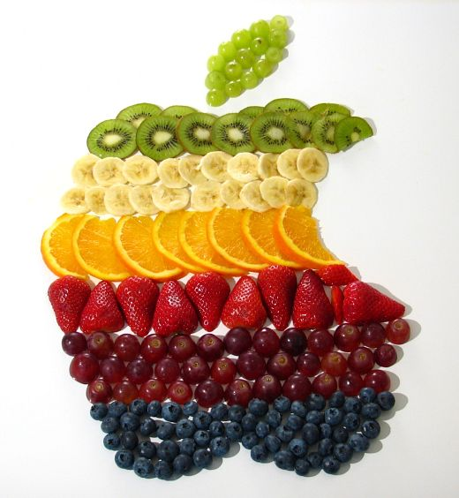
Think Smart?

Slide 13
Floriculture

Slide 14
Floriculture
Greenhouse growers produce
-cut flowers
-flowering potted plants
-foliage plants
-bedding plants

Slide 15
Cut Flowers
Sold to Florist
They are arranged into bouquets and sold to the public

Slide 16
Flowering Potted Plants
Sold in the containers in which they grew

Slide 17
Foliage Plants
Often sold in pots for use as house plants

Slide 18
Bedding Plants
Plants homeowners transplant into their flower gardens

Slide 19
Olericulture

Slide 20
Olericulture
Growing, harvesting, storing, processing, and marketing of vegetables.
Can also be done on a personal level with a family garden (so long as deer and other wildlife allow!)
Includes organic farms

Slide 21
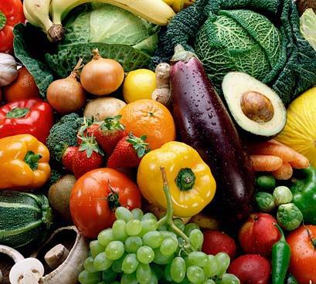

Slide 22
Careers in Horticulture Framework 1.3

Slide 23
Production Nursery
Propagator-produces new plants by grafting, budding, layering, and rooting, ,Supervisor
Inventory Manager-maintains records of all plant materials; number of plants by species, other data
Field Supervisor- supervises crew as they work in production. Responsible for states dangers
Manager-coordinates entire nursery

Slide 24
Landscape Nursery
Construction Supervisor- in charge of actual construction on site
Designer- prepares landscape designs
Salesperson-makes customers aware of the availability and quality of company for landscape work

Slide 25
Landscape Maintenance
Crew Supervisor-supervises workers on individual jobs and trains new workers
Superintendent of Operations-coordinates the maintenance jobs and assigns crews to specific jobs in larger firms
Salesperson-solicts jobs for the company among potential customers
Manager-coordinates all phases of the work and supervises maintenance work

Slide 26
Garden Center
Buyer- responsible for locating the sources and purchasing
Landscape Designers- develops and prepares designs for homeowners in small towns
Plant Technician- Specializes in plant problems
Manager- administrates and coordinates the entire marketing operation.

Slide 27
Horticulture in FFA Framework 1.4

Slide 28
Purpose of Nursery/Landscape
To stimulate career interest, encourage proficiency development and recognize excellence in students of nursery practices and landscaping through the agricultural education

Slide 29
Components
Written Exam
Annual Practicum
Rotational Practicum

Slide 30
Floriculture Purpose
To stimulate the study of and interest in production and retailing of flowers, plants and foliage through the agricultural education

Slide 31
Components
Written Exam
Individual Practicum
Team Activity
Plant Identification

